Slide 1

SCiN LT (FFF) Cadence
Week 13
03 APRIL 2023

Slide 2
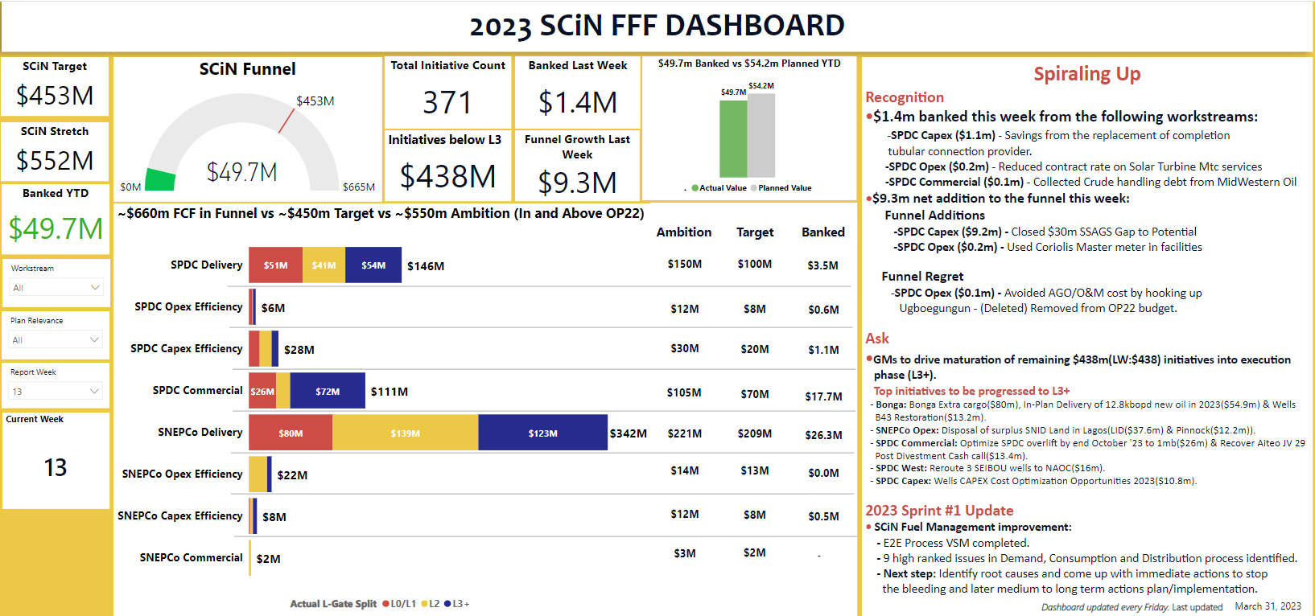

Slide 3
GAMECHANGER IMPLEMENTATION DASHBOARD - 31/03/2023
THEME 1: Digitalisation & Technology
Sponsor: Belinda, BOM: Jane-Frances
THEME 2 : Manage Supply Chain
Sponsor: Laurie, BOM: Tunde
SN | Focus Areas/Key Scope | Total Count | *Month plan (Mar) | YTD plan (End Mar) | YTD Actual | Updates, Commitments & Support Required
1 | Data Foundations | 2 | Nil | Nil |  | Q1: 3 initiatives deployed. Other initiatives ongoing BCMS: UAT ongoing - Completion expected in April. Single trip completion regretted in Ogbo-17. Well suspended due to drilling issues. Possible replacement & deployment in Q4.
2 | Focused Digital/Technology/ replication | 18 | 4 | 5 | 2
3 | Analytics | 4 | 1 | 2 | 1
4 | Automation | 4 | 0 | 0
SN | KPIs | YE Target | Actual YTD | Updates, Commitments & Support Required
1 | *Critical Contracts (CC) to be delivered. | 16 nos | 1 | Critical Contracts Details on Q1/2 contracts in Next slide. SNEPCo: EPCM delayed however recovery in progress (Q1 plan). MOT MSC GC working with Asset to improve the number of released PR’s. Material Preservation *¹ Reviews & engagements planned to secure additional funding to ensure more materials are captured in the plan. *² Mobilisation is done, to commence in April
 | % of Contracts expiring with replacements kickstarted (expiring within 18 months). | 100% | 87%
3 | *Delivery of the top 4 improvement initiative as per plan (%). | 100% | Stock accuracy @ 87%
4 | MOT (Critical materials on time at agreed date, %). | 100% | SNEPCo: 84% SPDC : 52%
5 | *Materials Preservation (Basic) – SPDC SNEPCo | 40203 13514 | SPDC: 4959 SNEPCo: 1960
6 | *Material Preservation (Specialised) SPDC SNEPCo | TBD*¹ 11633 | SPDC: Yet to start*² SNEPCo: 1063
THEME 3: Hydrocarbon Maturation
Sponsor: AR, BOM: Chuks
THEME 4 : Efficient External Interface
Sponsor/Co-Sponsor: Osagie/Bashir, BOM: Alan
SN | Projects* | DG3 Target (OP22) | LE | Updates, Commitments & Support Required
1 | Epu Ph3 | Jun-2023 | Jun-2023 | EPU – 3: All m/s for Q1 met toward DG3 in Jun-23. CSRA workshop ongoing 31/03/23. Clustering Campaign: NCDMB ITT certification obtained. Bid meeting planned for next week.
3 | Koloibiri | Sep-2023 | Sep-2023
3 | Nnwa Doro | Dec-2023* | Dec-2023*
4 | KCFS | Nov-2023 | Nov-2023
5 | Clustering Campaign | Jun-2023 (RTA) | Jun- 2023 (RTA)
SN | KPI | 2023 Target Delivery | LE | Updates, Commitments & Support Required
1 | Updated FEEP per Business (GMship) Full ESIMS deployment (incl reporting module) | Q1 Q1 | Q1 Q1 | FEEP development and ESIMs deployment: Prompt input received from Functions on FEEP update. Stakeholder Engagement Map Update completed.
2 | Stakeholder Engagement Map update | Q1 | Q1
3 | Complete Case-study based training per Function WD training pack for certification in place Deploy updated Business Compliance Mgt System ( BCMS Updated in GC1) | Jun Jun Jun | Jun Jun Jun
4 | Cost Recovery: Secure JV & PSC AWP/B. 2024 – Q3 100% Legacy eLDL cost reduction achieved | Q1 Dec | Q1 Dec
* DG2 ; RTA = Request to Award Contract
Simplification and Continuous Improvement of E2E Processes: Fuel Management, Approval Levels, RTP, ELDL

Slide 4
Q1/2 SPDC & SNEPCo Critical Contracts Status - 31/03/2023
Status Indicator legend

